Slide 1
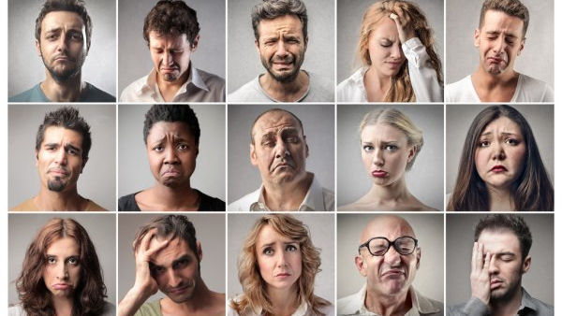
The Unhappy City
Recommendations to improve the overall health and happiness of South Bend’s residents
By Kathleen Roe, Caspar Hu, Ruoshui Lei, and Liam Kincaid

Slide 2
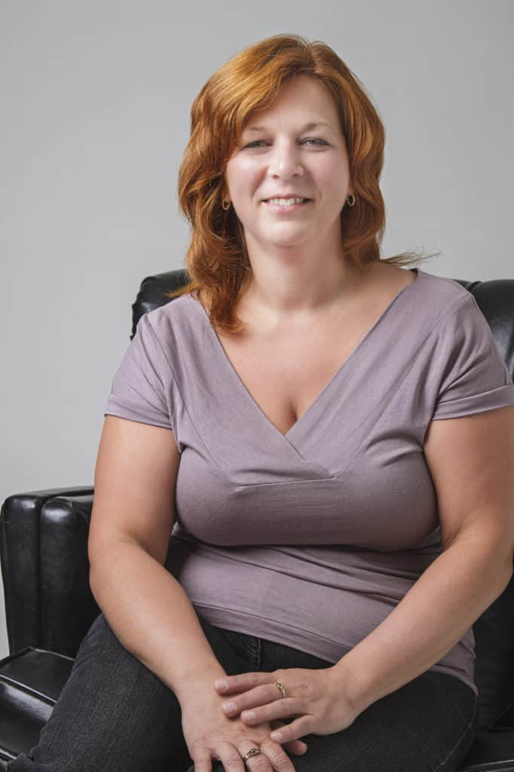
Cheryl
54 years old
Has high blood pressure and cholesterol
Looking for an easy, accessible place to play sports and stay active

Slide 3
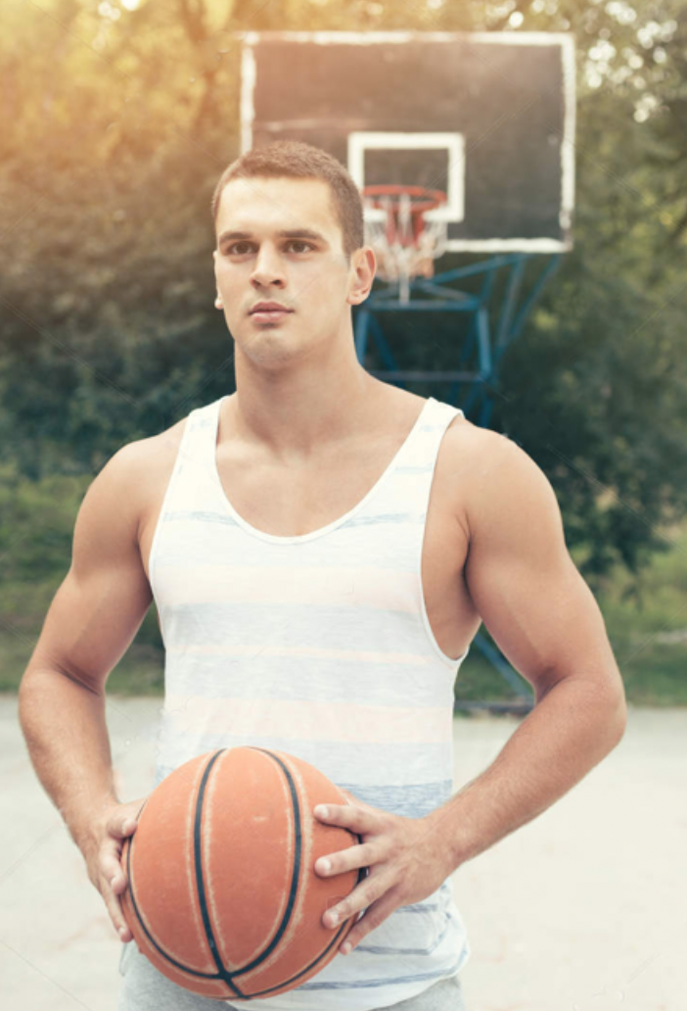
Brad
23 years old, single, and new to South Bend
Enjoyed playing basketball throughout college to stay in shape
In search of a place to play and meet new friends within his company that are his age and share his passion for sports

Slide 4
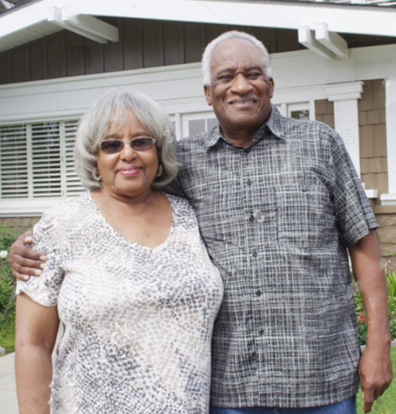
Roger and Ramona
Both 65 years old and recently retired
Looking to join a sports league with activities for local seniors
Roger suffers from arthritis
Searching for sports that are friendly towards people with his condition

Slide 5
4 very different people in search of one thing in common:
an outlet to play sports regularly with people their age, at an intensity that’s most suitable for them
An outlet to play sports regularly with people their age, at an intensity that’s most suitable for them

Slide 6

Table of Contents
01
Introduction
Problem
02
Solution
03
Benefits
04
Happiness and Health
South Bend Sports Club

Slide 7
Problem
South Bend Health and Overall Unhappiness
Notes:
“Unhappy Cities” study gathered health data from various metropolitan areas -> concluded that SB = 3rd unhappy city in country
But what are the factors that go into that? (a lot)
You might be thinking: what does this have to do with us?
One problem that you as the SBVPA can fix: Health = aid in the overall improvement of happiness

Slide 8
32%
182
39%
Of South Bend diabetics, 32% are considered high risk.
For every 100,000 people 182 will die of heart disease.
Of South Bend residents are obese.
Source: South Bend Tribune & Beacon Health
Notes:
3 numbers for you:
39% of residents are obese - For every 100k people, 182 will die of heart disease - 32% of diabetics are considered high risk

Slide 9
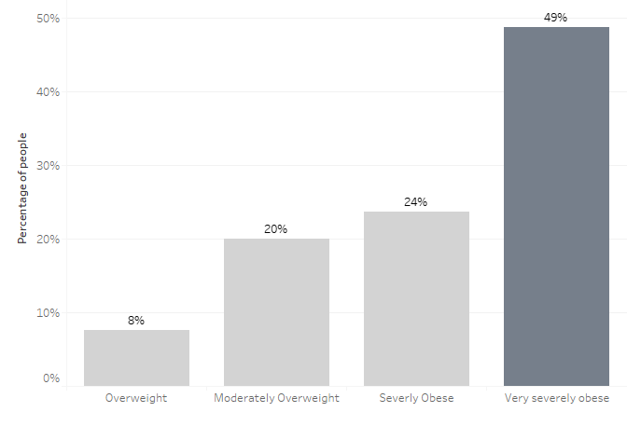
Almost half of the obese residents are considered very
severely obese.
Source: Beacon Health

Slide 10
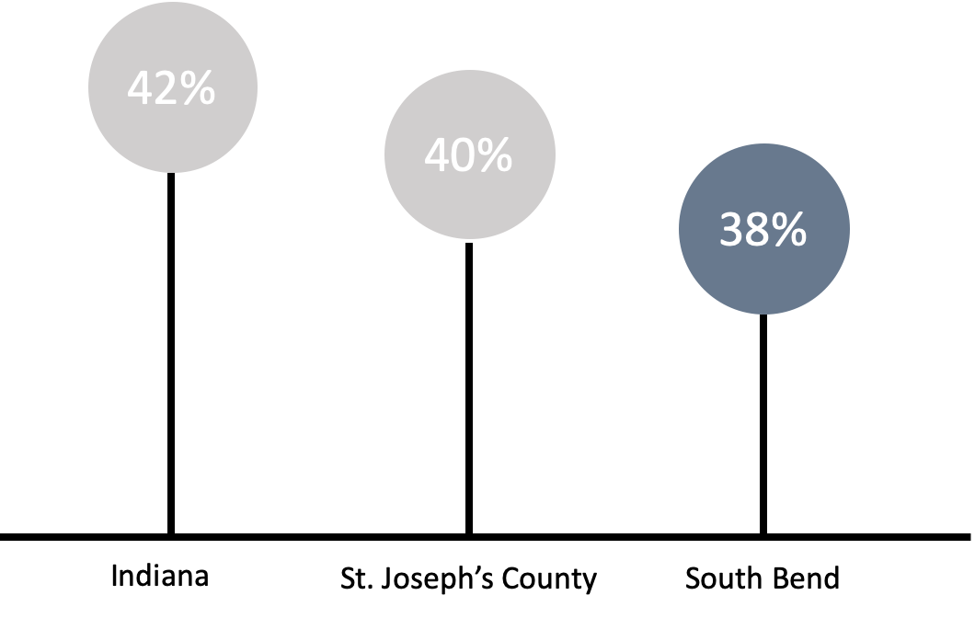
38% of South Bend residences doing moderately-intense recreational activities.
Source: City Data
Notes:
moderately -intense activities: briskly walking for 10 mins and golf

Slide 11
Solution
South Bend Sports Club

Slide 12
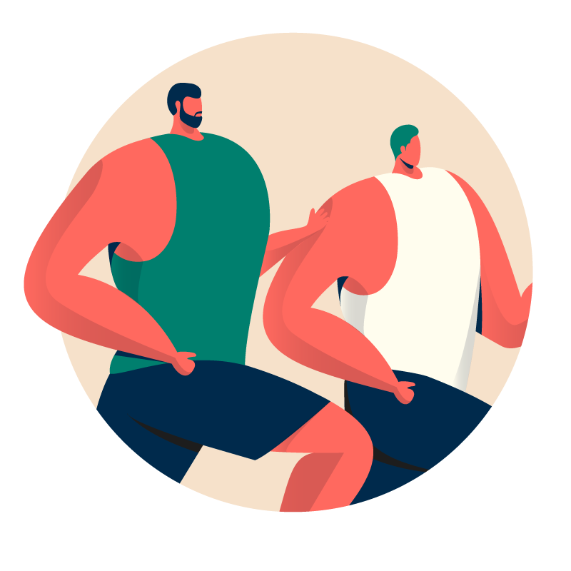
Purpose
Create an outlet for adults to play sports with people their age - within their business or without - and at an intensity best suited for them
SB
SC
Target Populations
Businesses
Individuals
SOUTH BEND SPORTS CLUB
Notes:
Currently, SBVPA has youth sports programs like youth basketball league. But we lacked sports programs for adults.

Slide 13
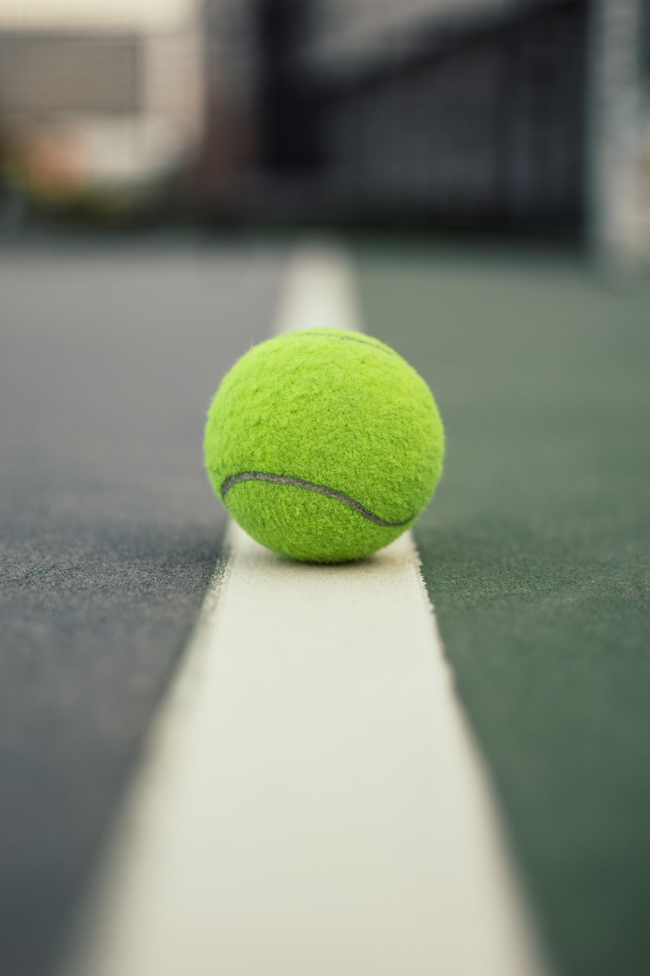
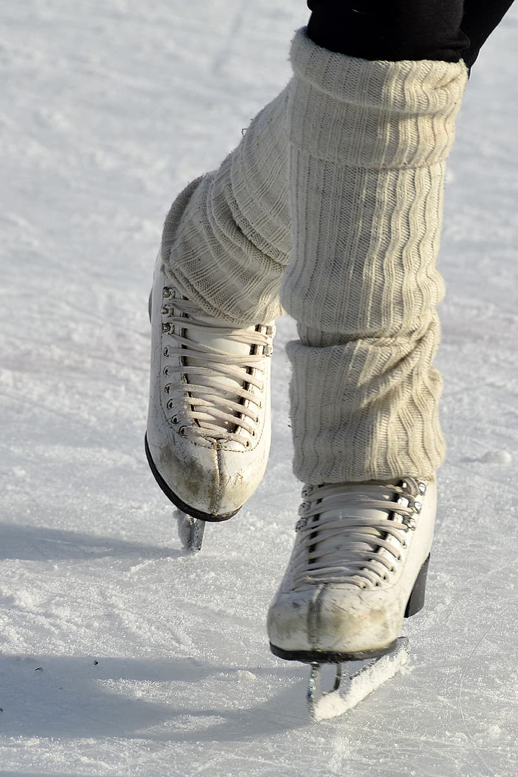
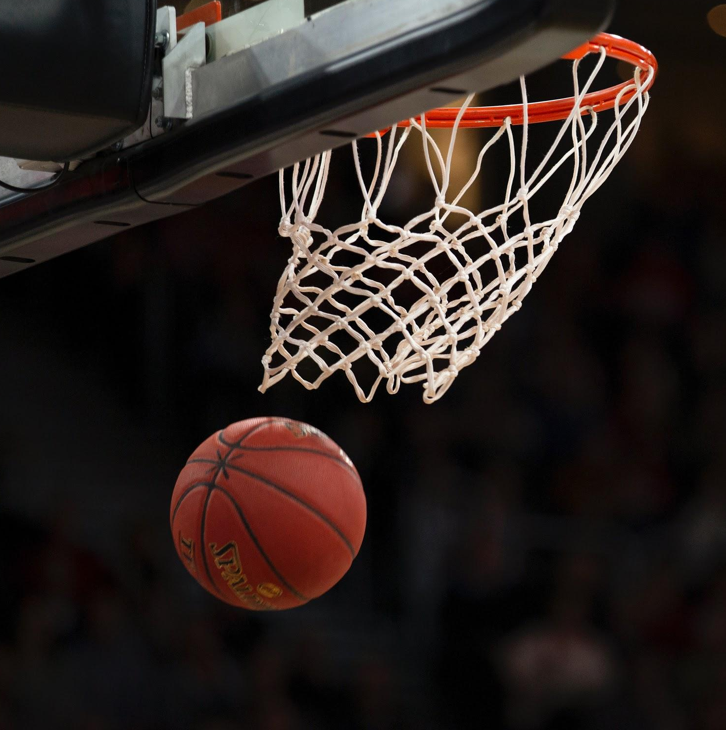
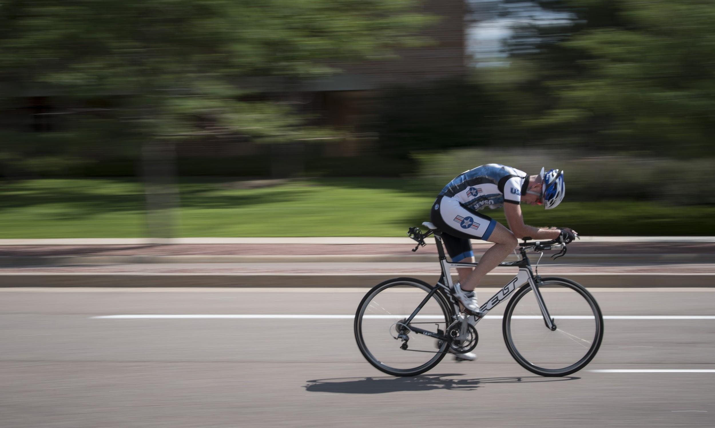
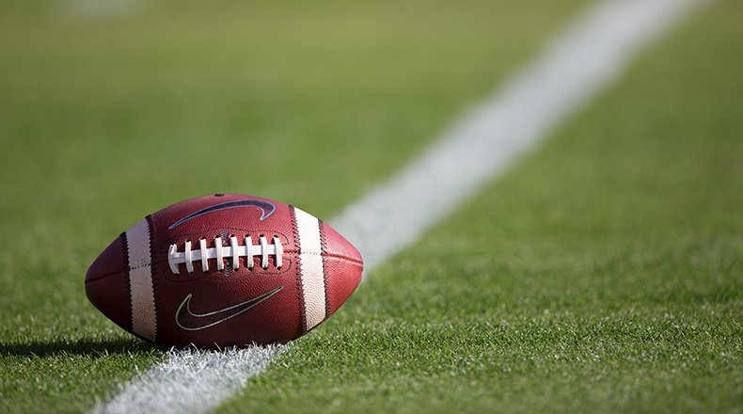
WHAT WE OFFER
More than a dozen sports for the general public, including...
Notes:
Companies / individuals internally decide which sports league to join
Employees Interest
Ages (young adults/elders)
Gender (Male/Female)

Slide 14
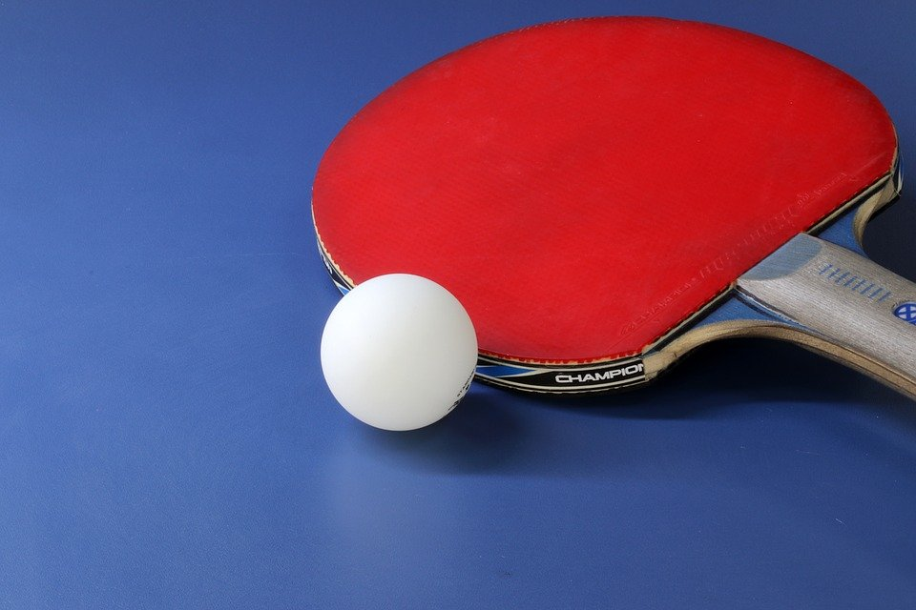
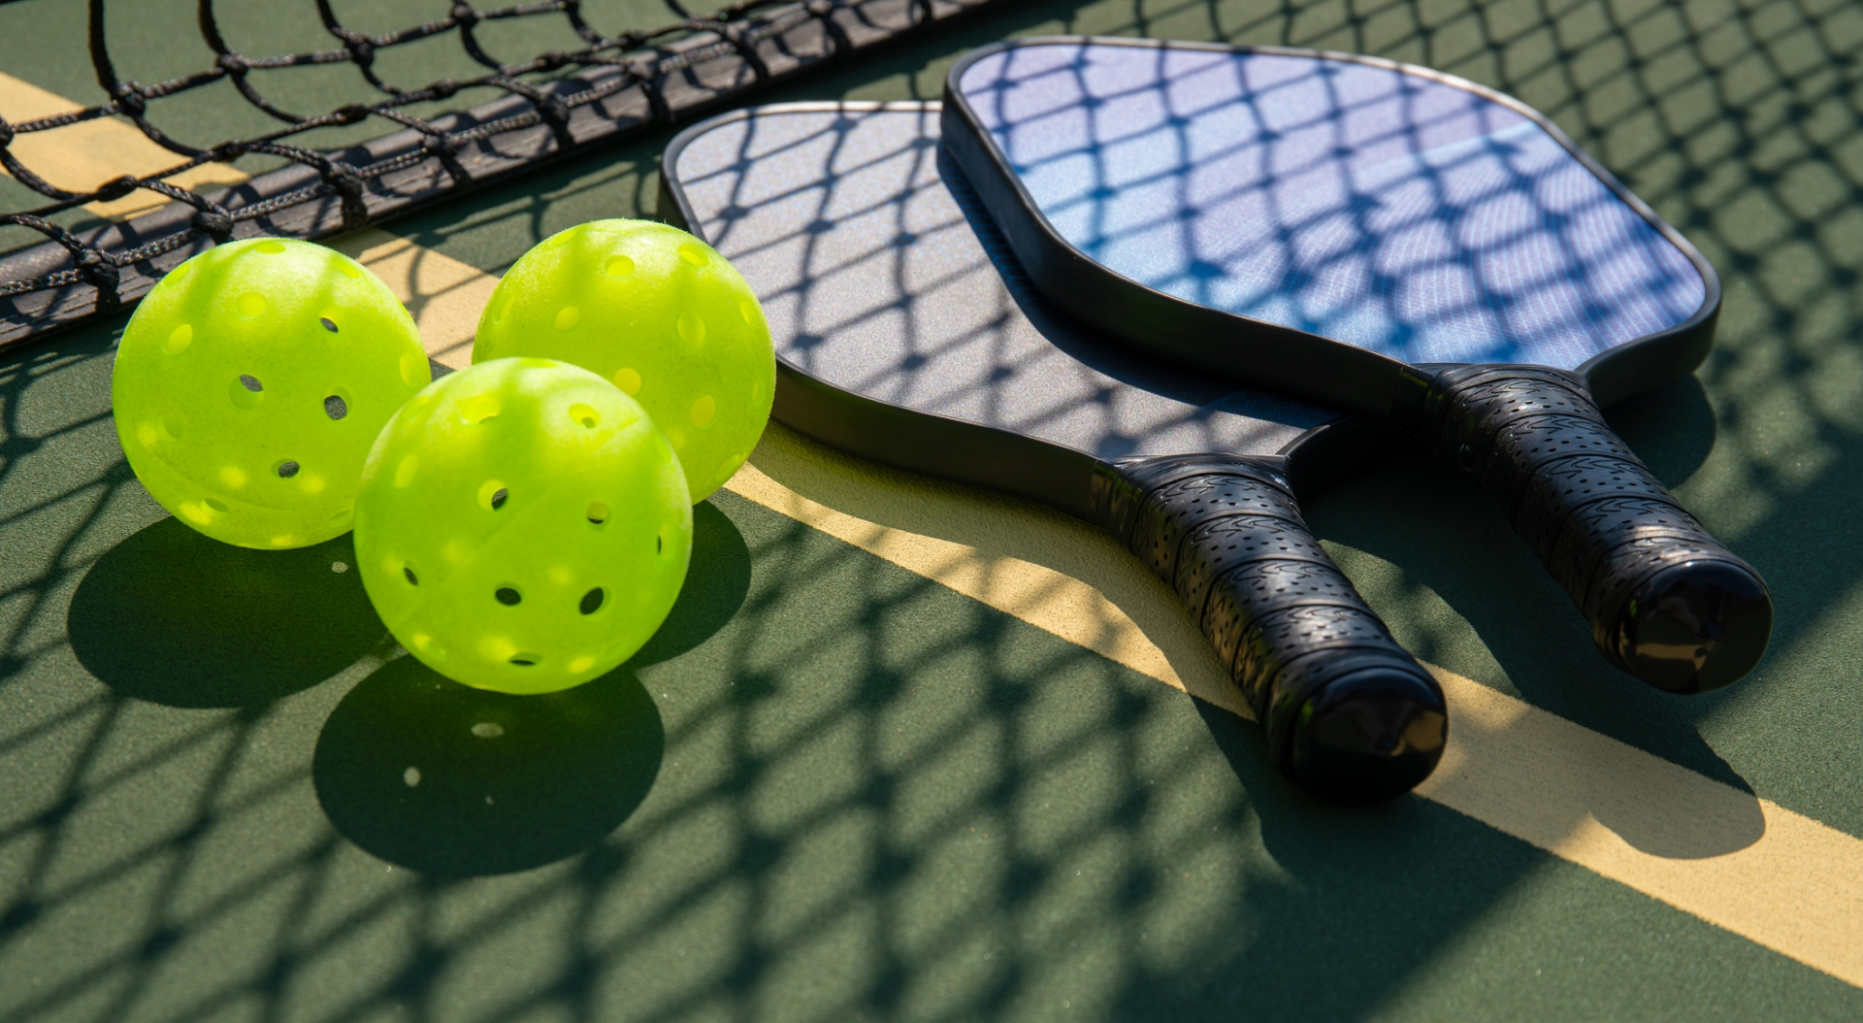
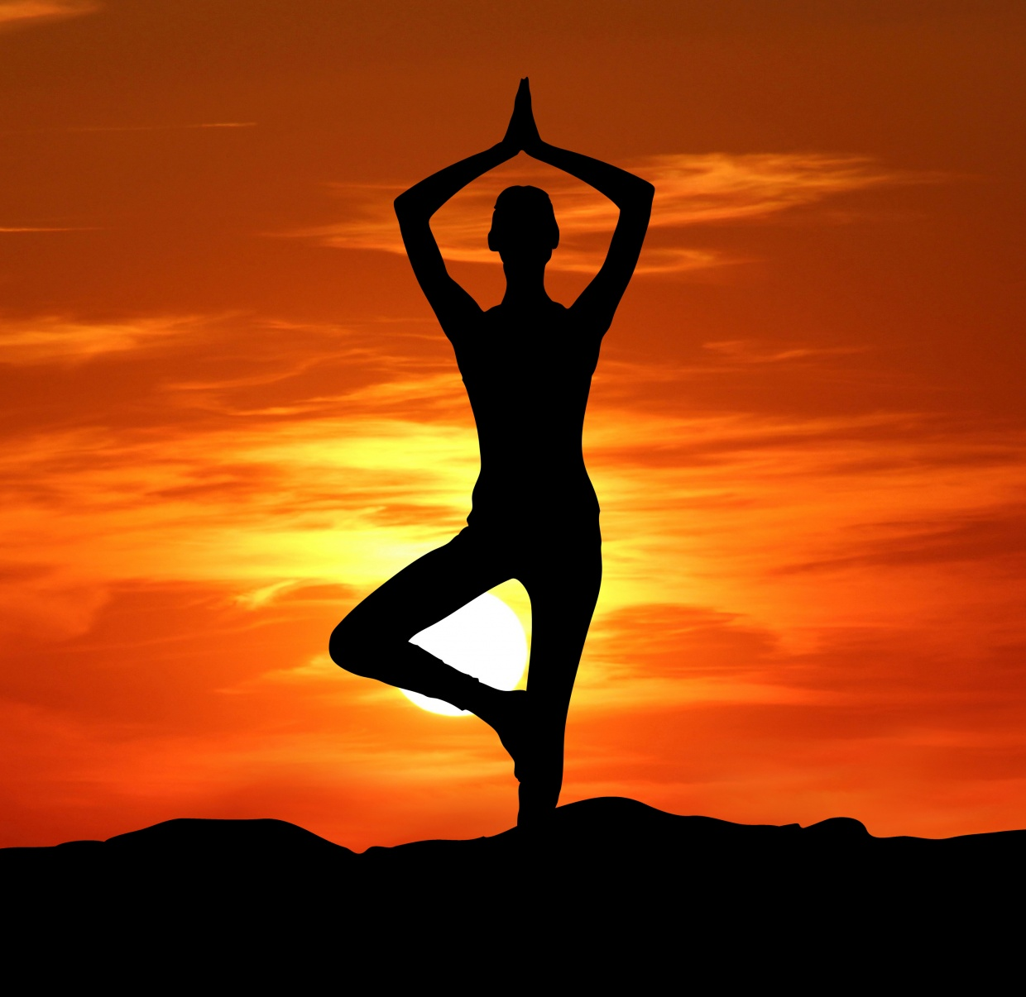
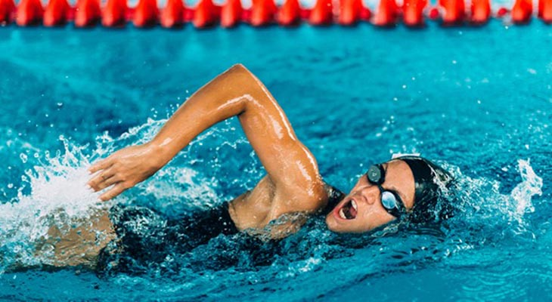
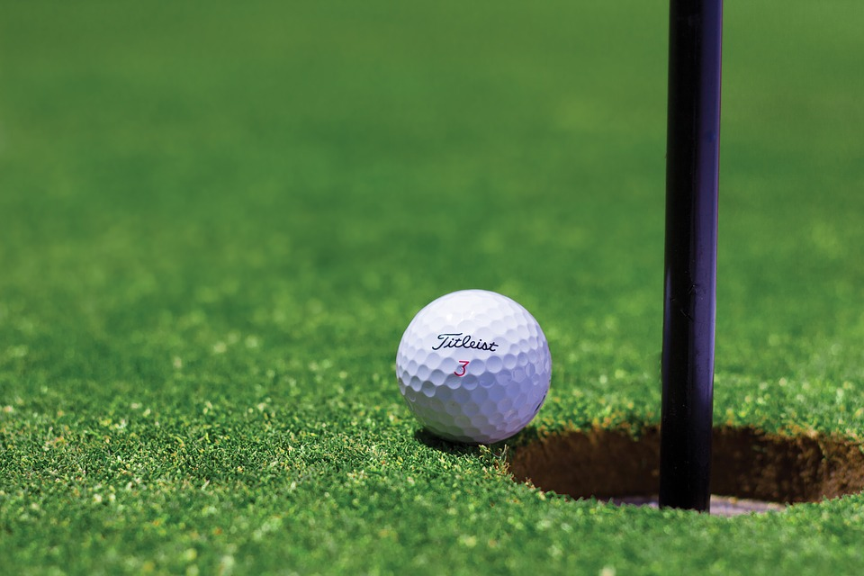
WHAT WE OFFER
...and over a half-dozen low-impact options perfect for seniors and those with chronic ailments.

Slide 15
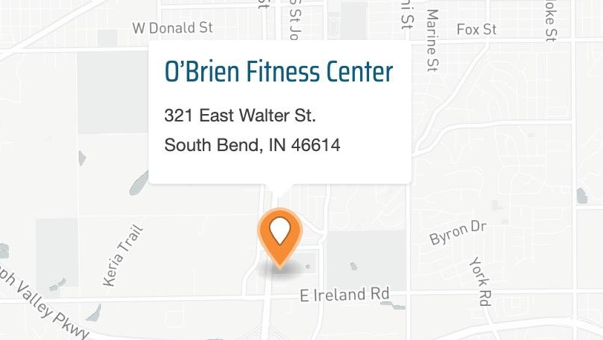
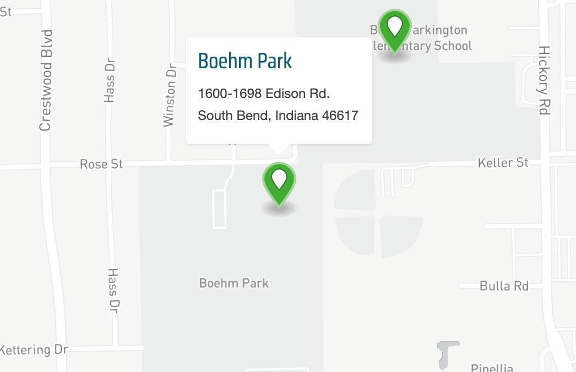
WHERE
Basketball Goals
Pickleball
Yoga Classes
Cycling
Football Field
Basketball Goals
Tennis Courts
Baseball Field

Slide 16
Register at SBVPA.com
Individual Teams
Corporate Teams
Yoga
Tennis
Basketball
Pickleball
Notes:
Participants register at SBVPA.com
They could sign up as individual teams or corporate teams. we can create tournaments in any sport for the teams to face-off in a customized challenge. The schedule of the competitions will also be customized based on their preference.

Slide 17
Benefits

Slide 18

Benefits for Physical Health
Improve self-image and elevated mood
Reduce depression
and anxiety
Enhance circulation
Source:

Slide 19

Benefits for Business
Employees...
Develop leadership skills
Strengthen bonds and camaraderie
Boost morale and productivity
Expand social and career networks

Slide 20
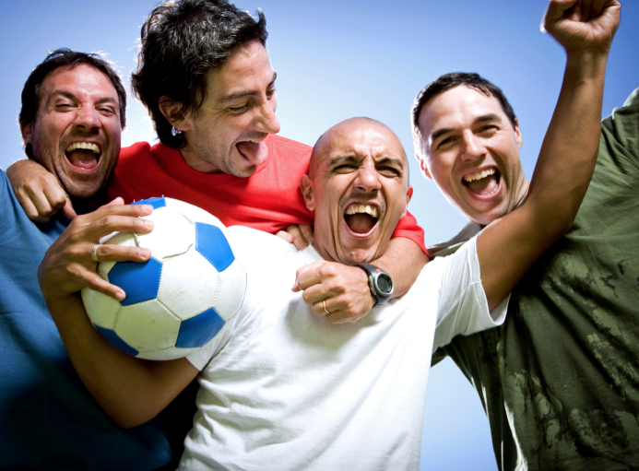
Benefits for the Community
Individuals…
Meet new people and get active too
Form teams and compete with other teams easily
Find a group of folks with similar interests/hobbies - (new to the area)

Slide 21
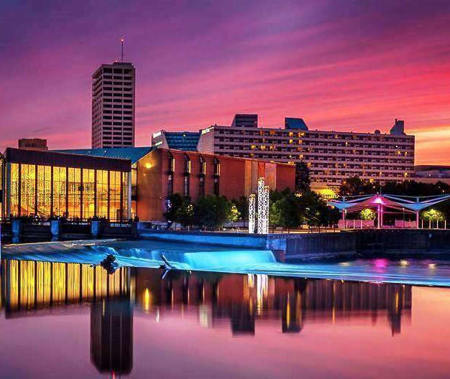
Benefits for YOU
SBVPA...
Enhance brand image and recognition through events
Increase usage of venues
Generate more revenue from the venues and all sorts of relevant activities
https://michianavegfest.org/wp-content/uploads/DOWNTOWN-SOUTHBEND-SUNSET-L.jpg

Slide 22
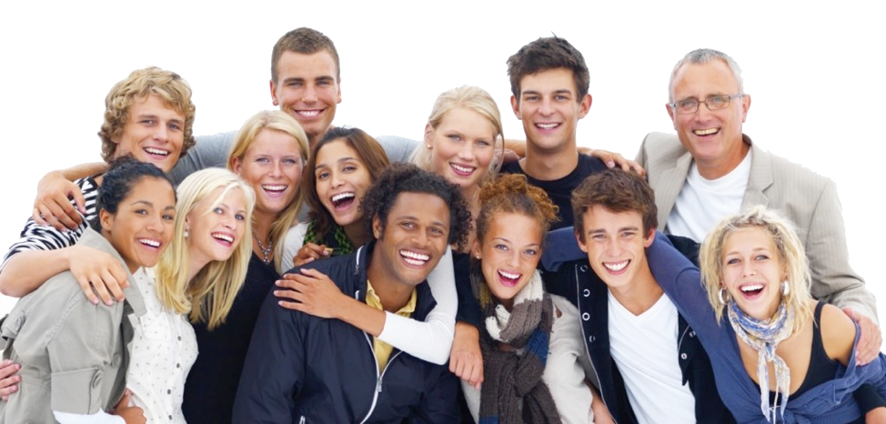
Accept our proposal and see HAPPY smiles again at South Bend
https://www.intuitocoaching.com/wp-content/uploads/2016/12/happy-faces.jpg

Slide 23
Thank you for watching
Do you have any questions?

Slide 24
Resources
South Bend Venues, Parks, and Arts. (2020, August 18). Retrieved October 29, 2020, from https://sbvpa.org/
https://athlonsports.com/college-football/college-football-week-11-2020-schedule-games-tv-times-dates
https://www.yahoo.com/entertainment/high-school-girls-basketball-team-wins-102-0-034119019.html
https://www.britannica.com/quiz/tennis
https://www.gardenofthegodsresort.com/things-to-do/pickleball/
https://michianavegfest.org/wp-content/uploads/DOWNTOWN-SOUTHBEND-SUNSET-L.jpg
https://www.alamy.com/stock-photo-collage-of-sad-people-138048887.html
https://www.intuitocoaching.com/wp-content/uploads/2016/12/happy-faces.jpg

